Slide 1
SE 361 Sprint #4 Review
Code Monkeys in Tech Support

Slide 2
Sprint Goals
Implement an FAQ page to view past tickets
Add functionality for users and support staff - View All Tickets
Both can view tickets
Both can resolve active tickets
Users can reopen tickets
Implement reporting manager page
Update user registration

Slide 3
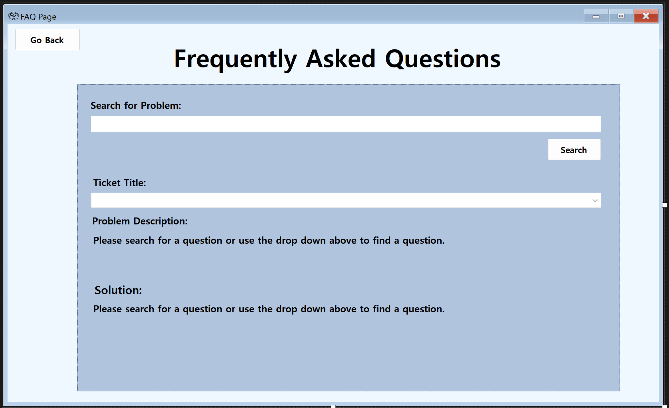
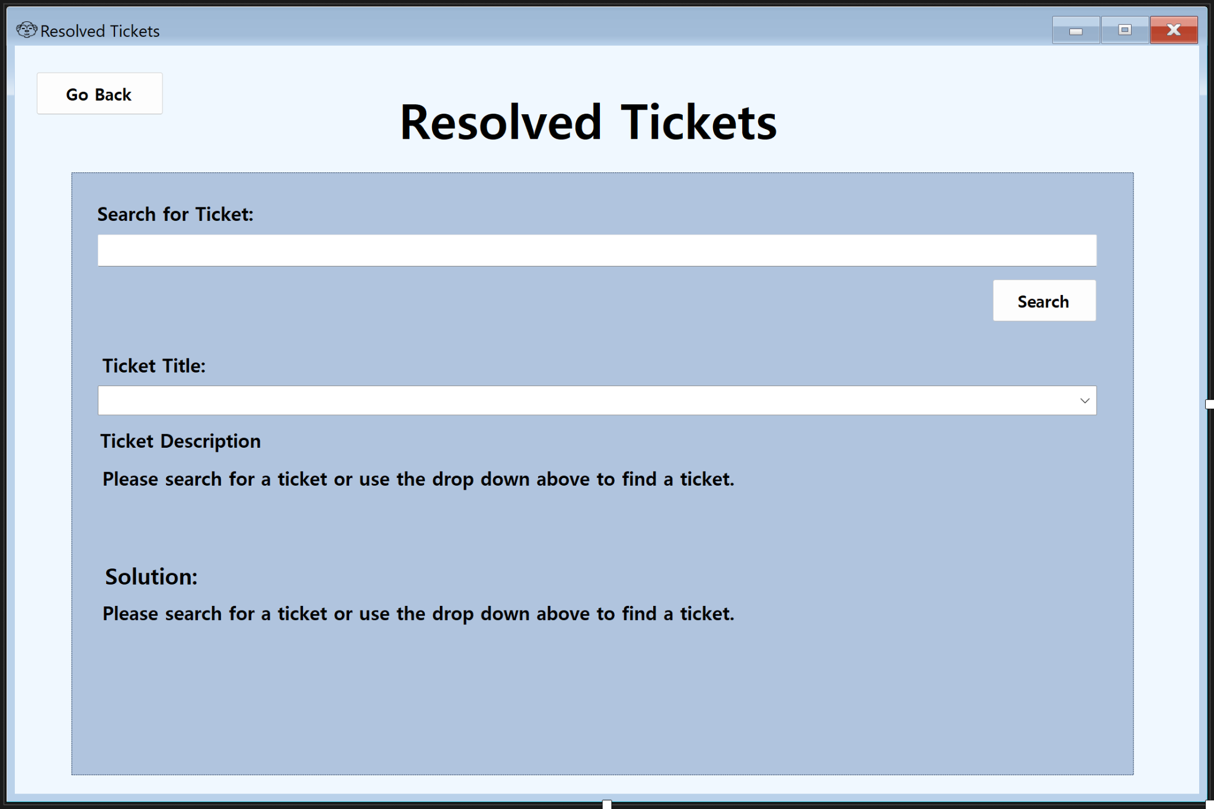
FAQ & Resolved Tickets
Similar designs for each
Difference is that FAQ shows the most common problems while Resolved Tickets shows ALL resolved tickets
FAQ functionality still in progress
Search bar still in progress, but drop down menu shows resolved tickets
Resolved Tickets page temporarily shows ticket description in solution, but we’re working on adding a solution attribute to our database

Slide 4
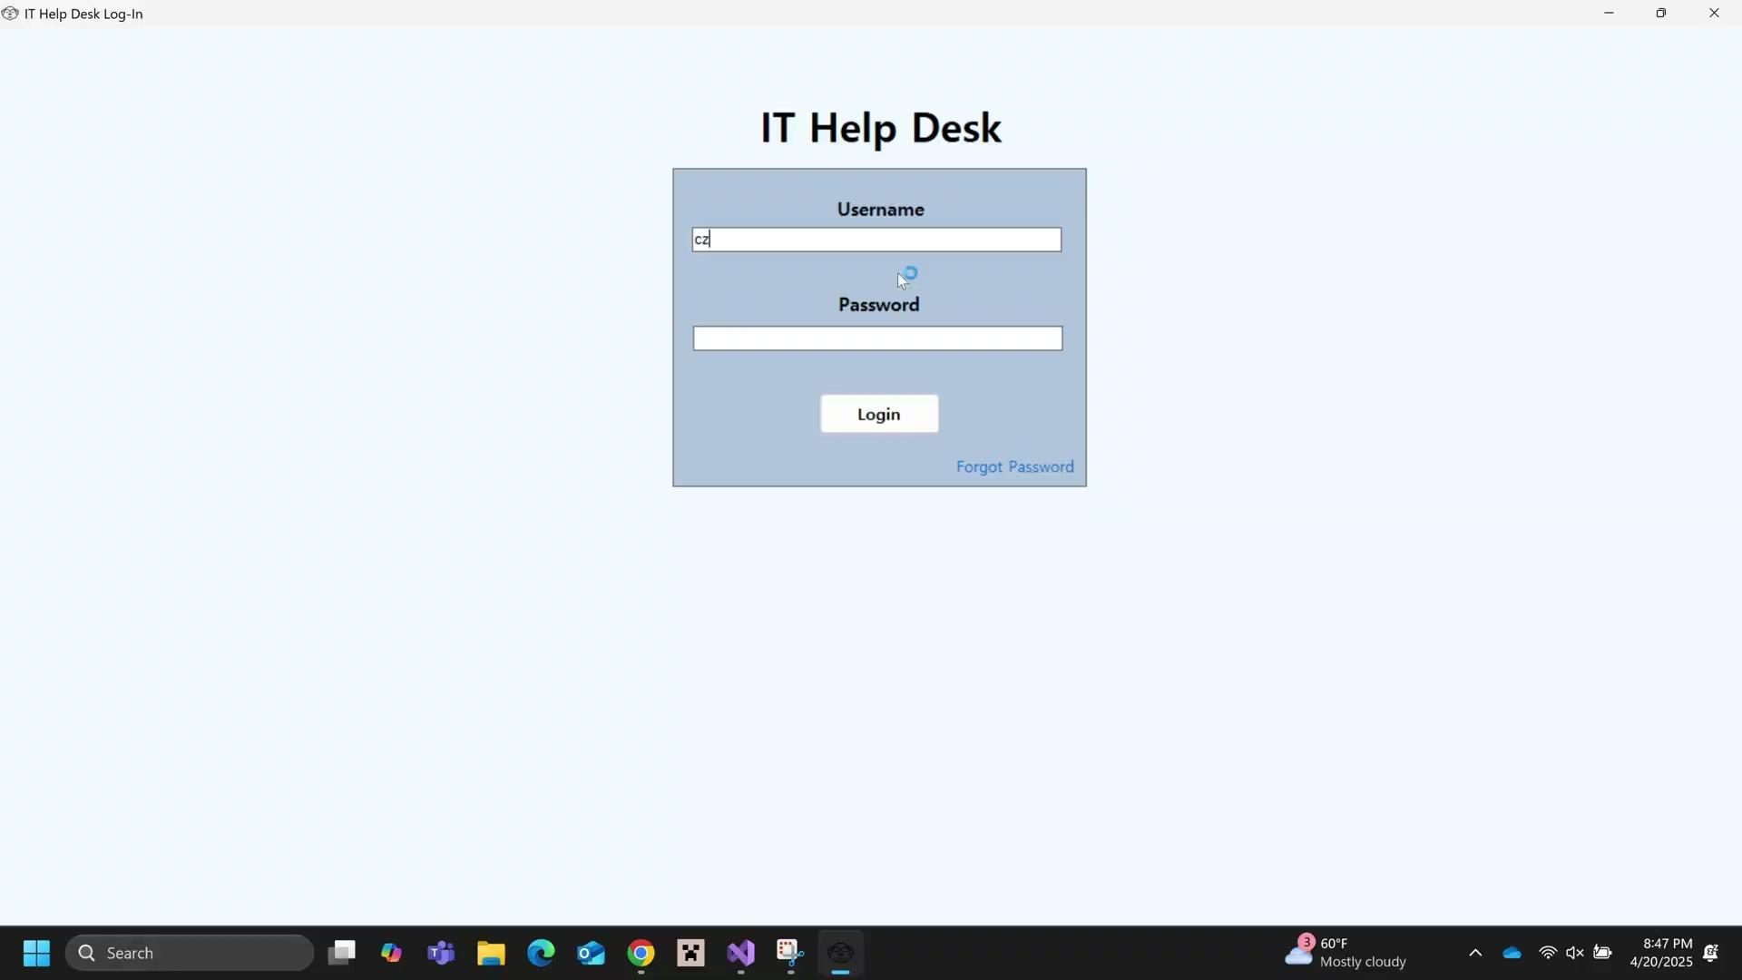
Resolved Tickets Demo

Slide 5
User and Active Tickets
Support Staff and Resolved Tickets
Tickets are automatically displayed for the user, sorted by creation date
Can filter tickets by status
Can view ticket details
Can resolve or reopen tickets
Able to resolve a ticket
An email is now sent to the user when support staff resolves a ticket

Slide 6
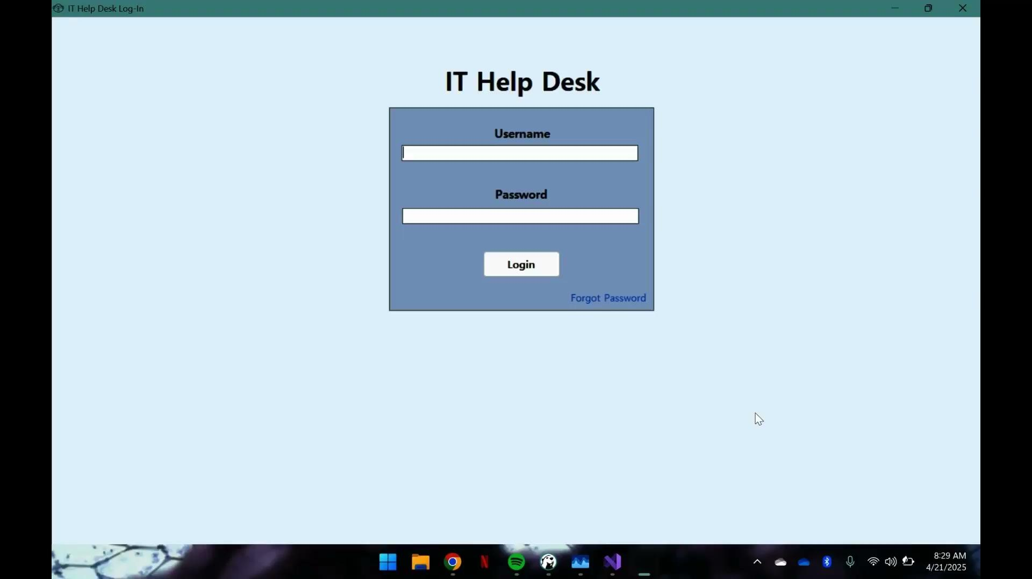
User demo

Slide 7
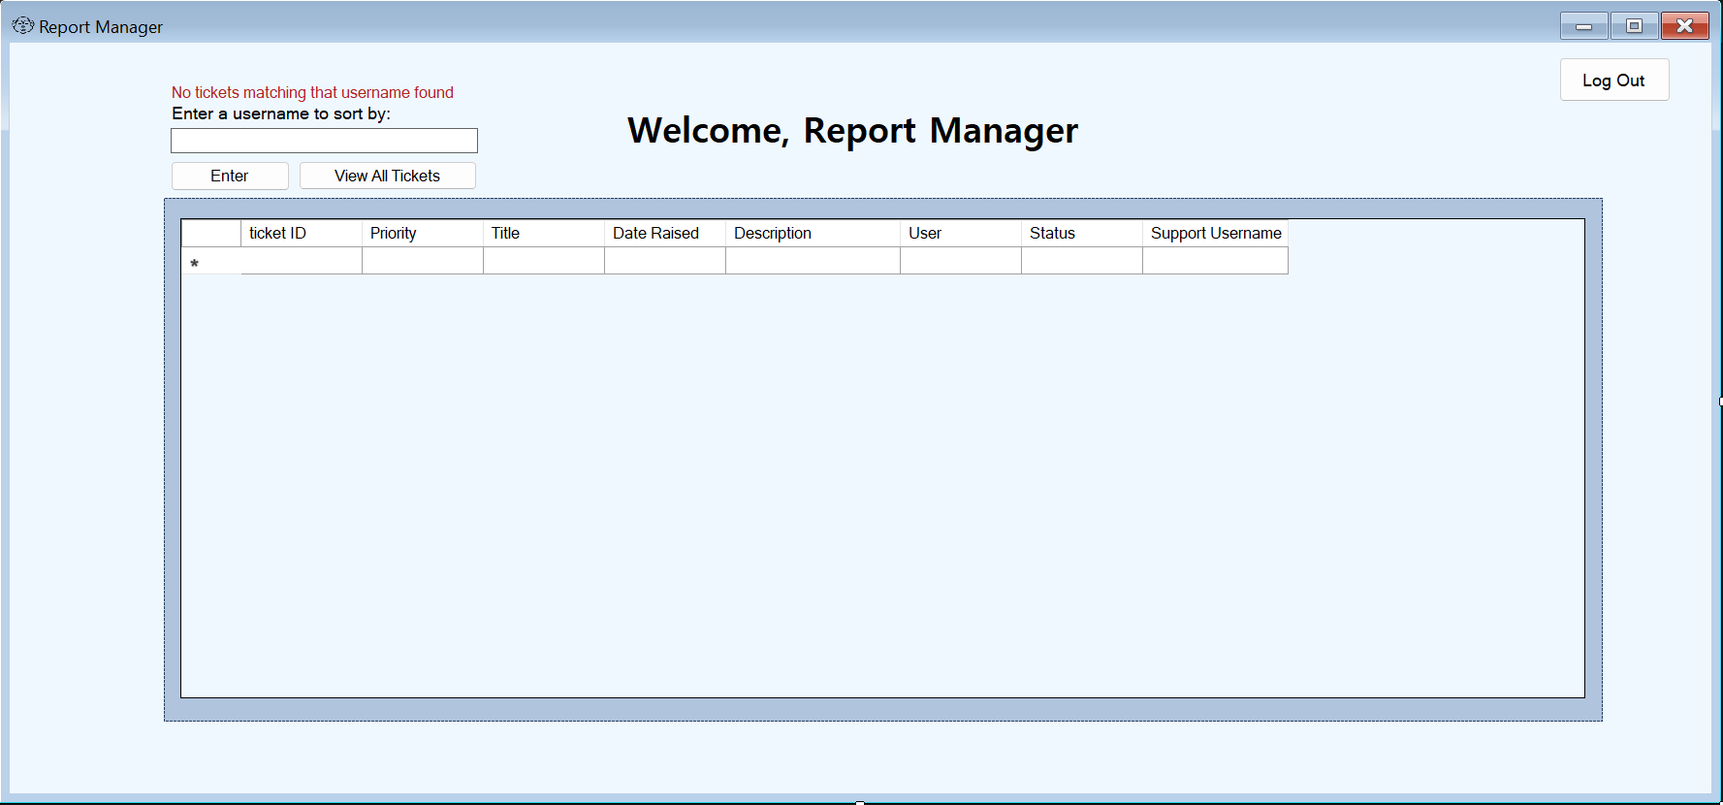
Report Manager Page
Updated GUI for the Report Manager Screen
Search functionality and database connection to fill in the rows with the information. (Credit to Beck for the help)
Working on being able to send email to Staff when they are assigned a ticket
Added timer to continuously update gridview with new data

Slide 8
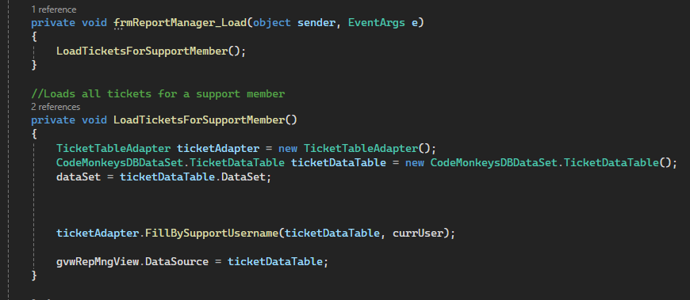
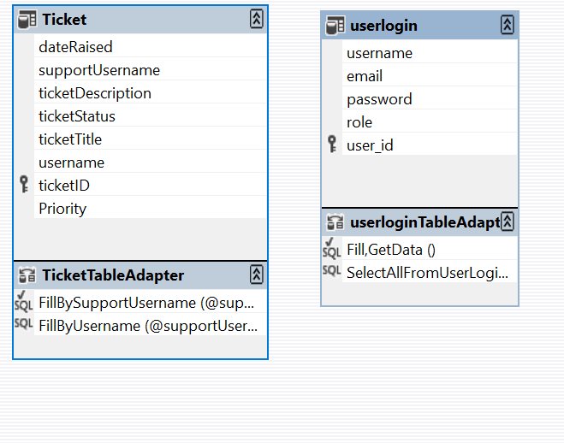
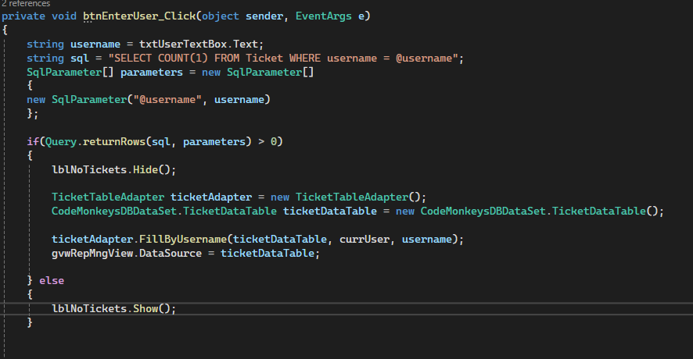
SqlDataAdapter Usage
← ~200 lines vs. ~80 lines

Slide 9
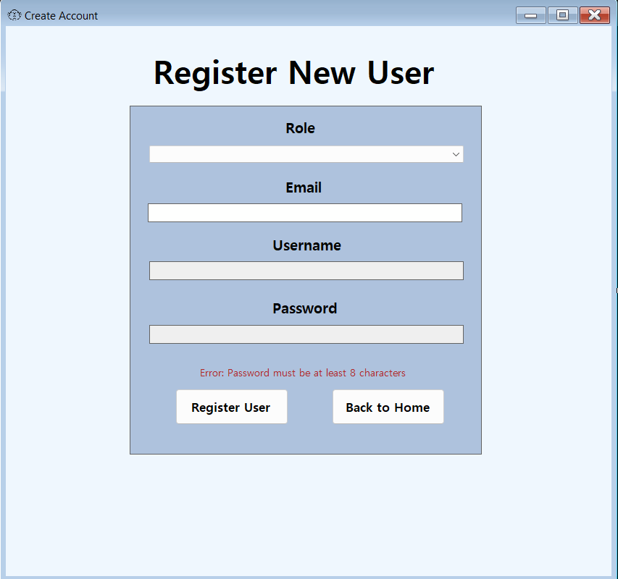
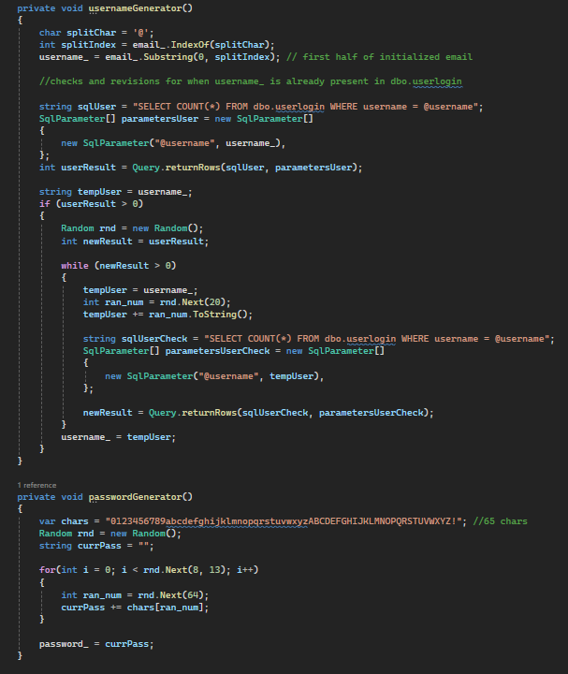
Updated Registration Page

Slide 10
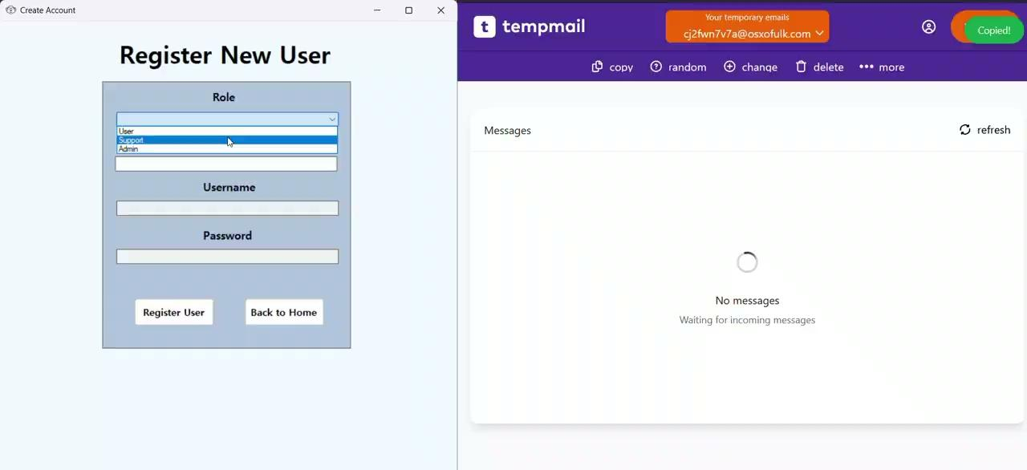
Registration Demo

Slide 11
Future Goals
Allow for support staff to upload a solution
Implement report generation
Finalize FAQ & Solved tickets
Allow for admin to upload files
Implement search function for FAQ page
GUI cleanliness & branding
Refactoring & code cleanliness

